Slide 1
CHGM-141
General and Analytical Chemistry I
Lecture 12
(Ch. 4)
with Dr. Bailey
Covalent Bonding
Electron-Dot Structures
Resonance
Formal Charge

Slide 2
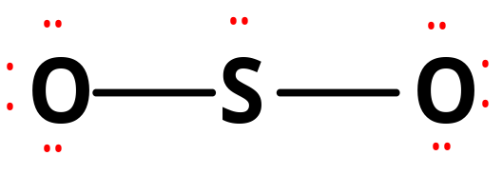
Sulfur Dioxide, SO₂
1. Central atom = S
2. Valence electrons = 18 or 9 pairs
3. Form double bond so that S has an octet — but note that there are two ways of doing this.
bring in
OR bring in
left pair
right pair
••
••
••
O
S
O
•
•
•
•
••
••

Slide 3
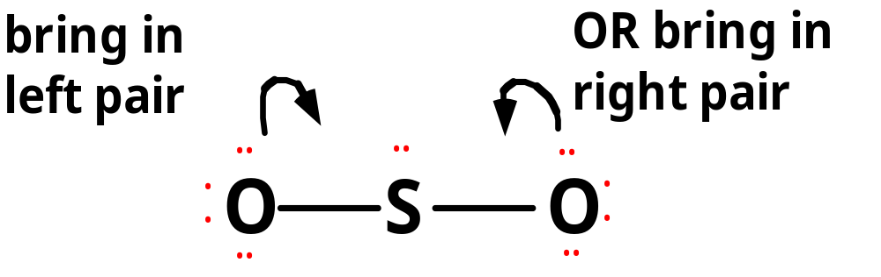
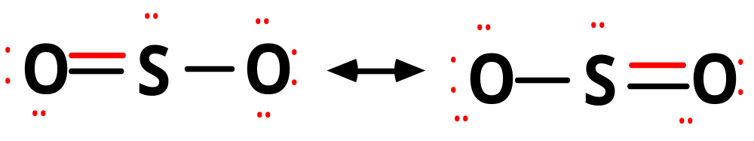
Sulfur Dioxide, SO₂
This leads to the following structures.
These equivalent structures are called
RESONANCE STRUCTURES: differ only in the position of the electrons.
The true electronic structure is a HYBRID of the two.

Slide 4
Resonance
when there is more than one Lewis structure for a molecule that differ only in the position of the electrons, they are called resonance structures
the actual molecule is a combination of the resonance forms – a resonance hybrid
look for multiple bonds or lone pairs
••
O S O
••
••
••
••
••
•
•
••
••
•
•
•
•
•
•
•
•
••
••
•
•
••
••

Slide 5
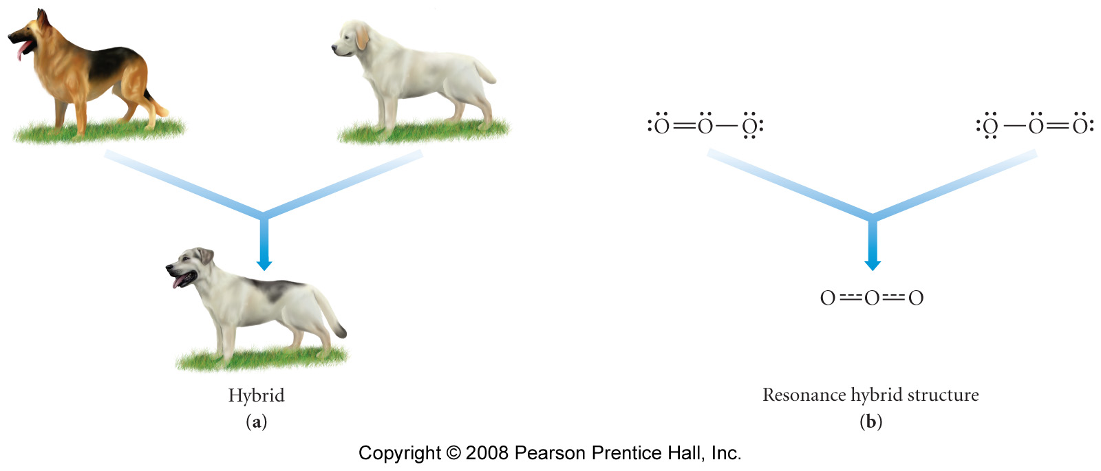
Resonance
(Resonance Hybrid)
Predominant resonance structure…

Slide 6
Formal Atom Charges
Atoms in molecules often bear a charge (+ or -).
Formal charge
= Group number
– 1/2 (no. of bonding electrons)
- (no. of LP electrons)
The predominant resonance structure of a molecule is the one with charges as close to 0 as possible.

Slide 7
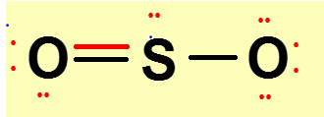
Formal Atom Charges
Formal charge
= Group number
– 1/2 (no. of bonding electrons)
- (no. of LP electrons)
left O FC = 6 - ½ (4) - 4 = 0
S FC = 6 - ½ (6) - 2 = +1
right O FC = 6 - ½ (2) - 6 = -1
sum of all the formal charges in a molecule = 0
  in an ion, total equals the charge
O S O
••
••
••
•
•
•
•
•
•
•
•
••
••

Slide 8
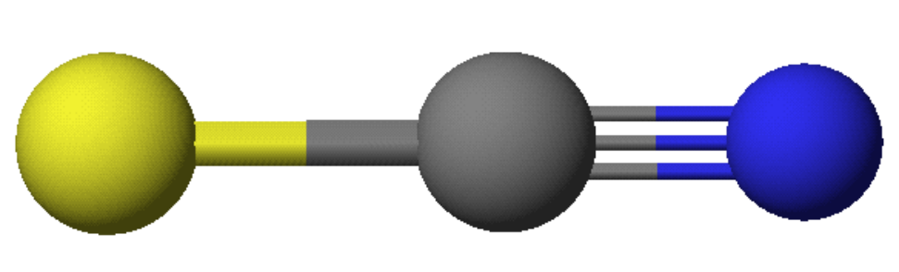
Thiocyanate Ion, SCN⁻
6 - (1/2)(2) - 6 = -1
5 - (1/2)(6) - 2 = 0
•
•
•
S
C
N
•
•
•
•
•
4 - (1/2)(8) - 0 = 0

Slide 9
Thiocyanate Ion, SCN⁻
•
•
•
•
•
•
S
C
N
•
S
C
N
•
•
•
•
•
•
•
•
•
•
•
•
S
C
N
•
•
•
•
•
Which is the most important resonance form?

Slide 10
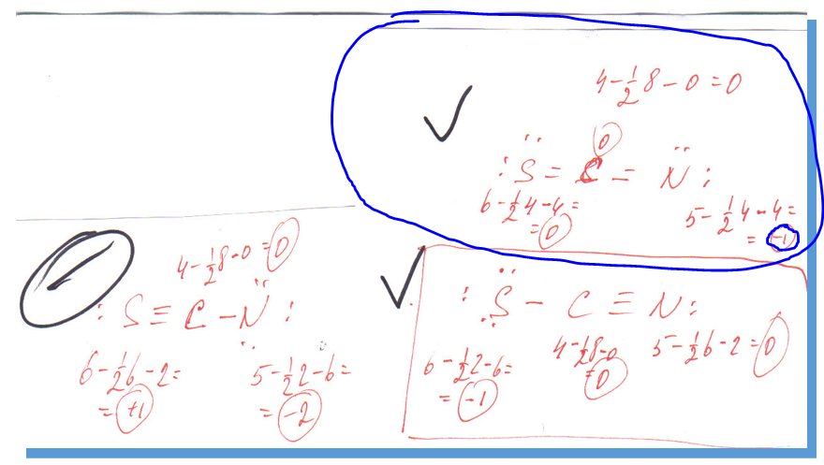
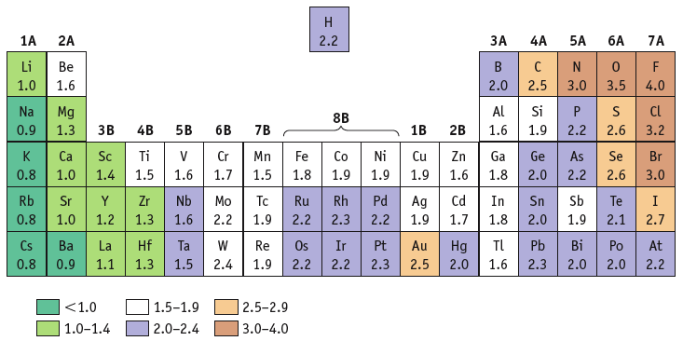
Better structures have
(− ) formal charge on more electronegative atom

Slide 11
Rules of Resonance Structures
In Summary:
Resonance structures must have the same connectivity
  only electron positions can change
Resonance structures must have the same number of electrons
Second row elements have a maximum of 8 electrons
  bonding and nonbonding
  third row can have expanded octet
Better structures have fewer formal charges
Better structures have smaller formal charges
Better structures have (−) formal charge on more electronegative atom

Slide 12
Draw an electron-dot structure for O₃
(one more example)
Step 1: 3(6) = 18 valence electrons
Step 2:
O
O
O
Step 4:
O
O
O
Step 3:
O
O
O
Step 5:
O
O
O
Notes:
Step 4: There is only 1 more pair of electrons. Thus, the central oxygen only has 3 pairs of electrons (less than an octet).
Step 5: There is a choice to be made. If all that is desired is the electron-dot structure, then either of the 2 terminal oxygen atoms could have been chosen.

Slide 13
Electron-Dot Structures and Resonance
Move a lone pair from this oxygen?
Step 4:
O
O
O
Or move a lone pair from this oxygen?
O
O
O
O
O
O
Resonance
A bond analysis actually shows one type of bond, and it’s neither a single nor a double bond.
Notes:
Either electron-dot structure suggests that ozone has a double and a single bond. A bond analysis actually shows one type of bond, and it’s neither a single nor a double bond. A resonance hybrid attempts to overcome this shortcoming of electron-dot structures.
At this stage, we usually just take this simplified look at resonance structures. Organic chemistry, for example, takes a much deeper look at resonance.

Slide 14
Electron-Dot Structures and Formal Charge
# of
valence e–
in free atom
# of
bonding
e–
# of
nonbonding
e–
Formal
Charge
1
=
–
–
2
Calculate the formal charge on each atom in O₃.
O
O
O
1
1
1
6 – (4) – 4 = 0
6 – (6) – 2 = +1
6 – (2) – 6 = –1
2
2
2
Notes:
The sum of the formal charges will be equal to the overall charge of the molecule or ion.

Slide 15
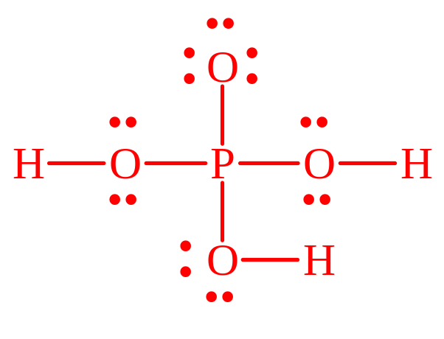
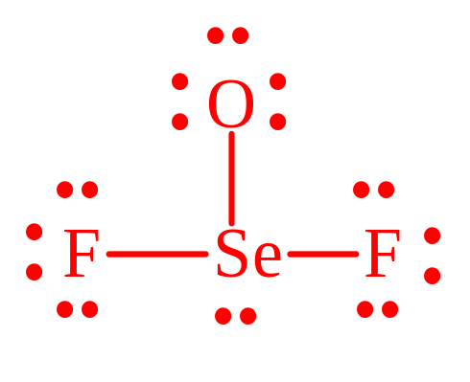
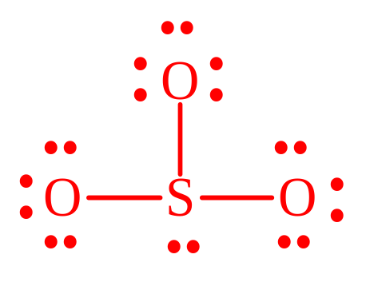
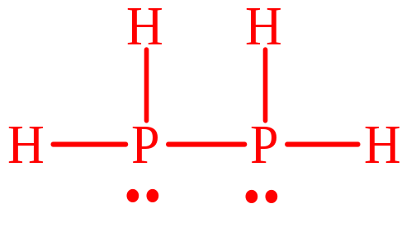
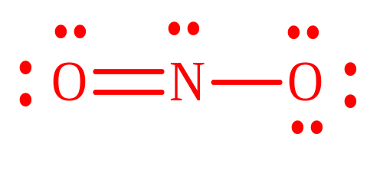
Practice - Assign Formal Charges
CO₂
SeOF₂
NO₂⁻¹
H₃PO₄
SO₃⁻²
P₂H₄

Slide 16
Practice - Assign Formal Charges
-1
CO₂
SeOF₂
NO₂⁻¹
H₃PO₄
SO₃⁻²
P₂H₄
P = +1
rest 0
all 0
-1
-1
Se = +1
S = +1
-1
-1
-1
all 0

Slide 17
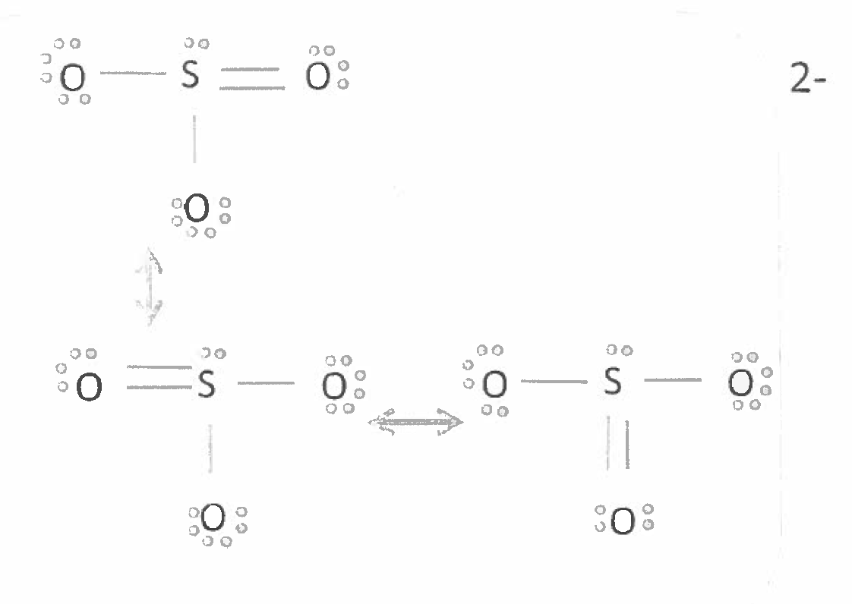


Slide 18
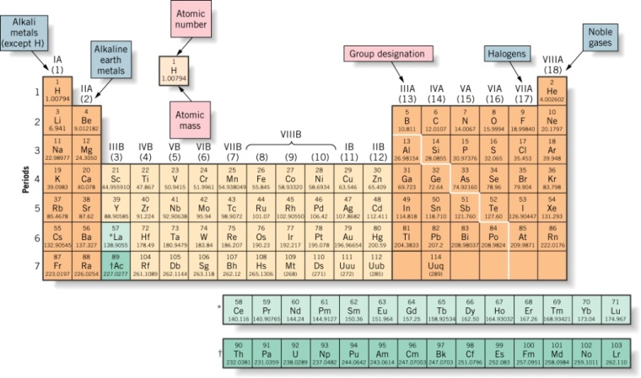
Exceptions to the Octet Rule
Violations of the Octet Rule
expanded octets
  elements with empty d orbitals can have more than 8 electrons
odd number electron species e.g., NO
  will have 1 unpaired electron
  free-radical
  very reactive
incomplete octets
  B

Slide 19
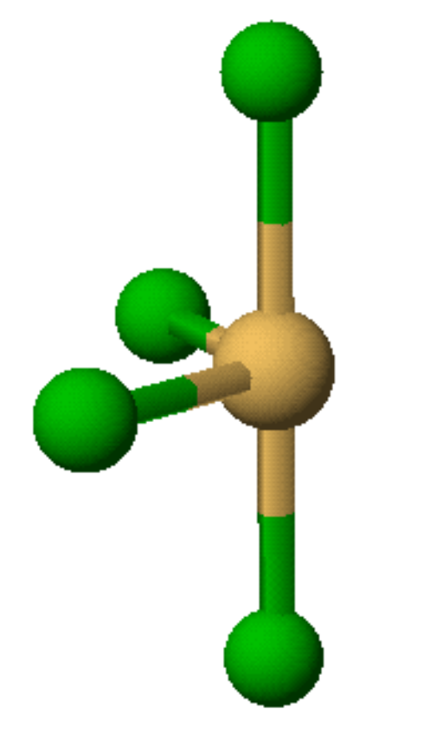
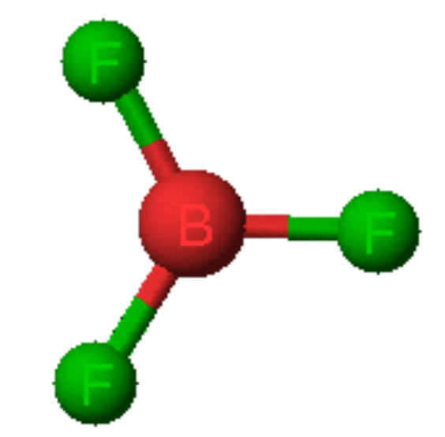
Violations of the Octet Rule
Usually occurs with B and elements of higher periods.
BF₃
SF₄

Slide 20
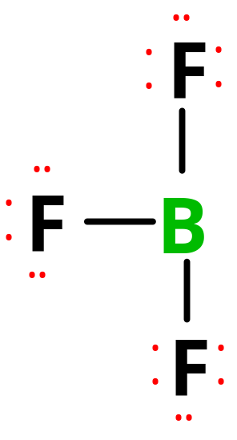
Boron Trifluoride
Valence electrons = __24________ or electron pairs = _12_________
Assemble dot structure
Central atom = __B___________
The B atom has a share in only 6 electrons (or 3 pairs).
B atom in many molecules is electron deficient. Incomplete octet!

Slide 21
Boron Trifluoride, BF₃
F
•
+1
•
•
•
••
-1
•
F
B
•
••
•
F
•
•
•
••
What if we form a B—F double bond to satisfy the B atom octet?
Formal charge
= Group number
– 1/2 (no. of bonding electrons)
- (no. of LP electrons)
Better structures have
(− ) formal charge on more electronegative atom

Slide 22
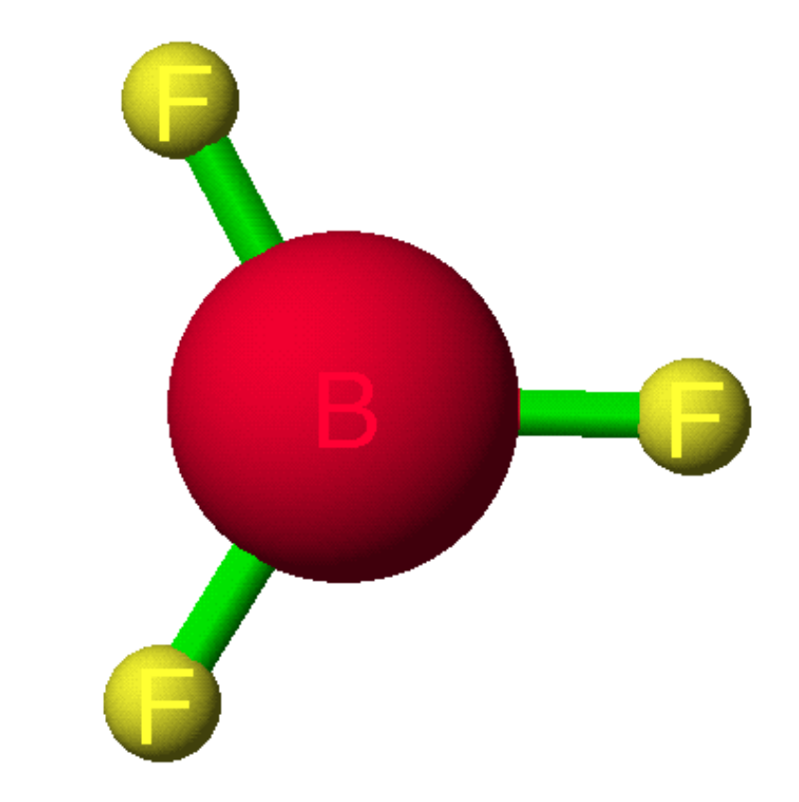
Is There a B=F Double Bond in BF₃ ?
Calc’d partial charges in BF₃
F is negative and B is positive
Better structures have − formal charge on more electronegative atom

Slide 23
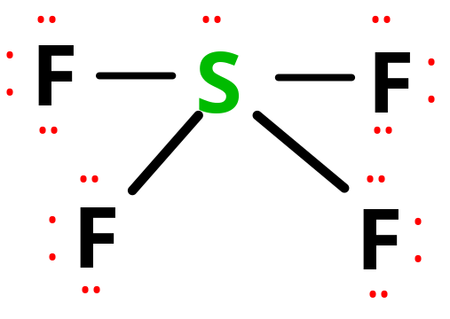
Sulfur Tetrafluoride, SF₄
Central atom =
Valence electrons = ___ or ___ pairs.
Form sigma bonds and distribute electron pairs.
5 pairs around the S atom. A common occurrence outside the 2nd period.
Expanded octet!

Slide 24
Electron-Dot Structures of Compounds Containing Elements Below the Second Row (More examples)
Draw an electron-dot structure for SF₆
(sulfur hexafluoride)
Step 1: 6 + 4(7) = 34 valence electrons
F
F
F
F
F
F
Step 2:
S
Step 3:
S
F
F
F
F
F
F
Step 2: The central atom is in row 3 so there can be more than 8 electrons.
Notes:
Step 2: The central atom is in row 3 so there can be more than 8 electrons.
Step 4: There are no remaining electrons.
Step 5: The central atom has at least 8 electrons so no multiple bonding.

Slide 25
Electron-Dot Structures of Compounds Containing Elements Below the Second Row
Draw an electron-dot structure for ICl₃.
(iodine trichloride)
Step 1: 7 + 3(7) = 28 valence electrons
Cl
Cl
Cl
Cl
Cl
Cl
Step 2:
I
Step 4:
I
Step 4: The remaining electrons go on the central atom.
Step 5: The central atom has at least 8 electrons so no multiple bonding. Expanded octet!
Cl
Cl
Cl
Step 3:
I
Notes:
Step 4: The remaining electrons go on the central atom.
Step 5: The central atom has at least 8 electrons so no multiple bonding.

Slide 26
What is the formal charge on each atom in chloroform, CHCl₃?
C atom = 0, H atom = 0, and each Cl atom = 0
C atom = 0, H atom = +1, one Cl atom = -1, and two Cl atoms = 0
C atom = +4, H = -1, and each Cl atom = -1
C atom = +2, H = +1, and each Cl atom = -1
C atom = -4, H = +1, and each Cl atom = +1
Formal charge
= Group number
– 1/2 (no. of bonding electrons)
- (no. of LP electrons)

Slide 27
What is the formal charge on each atom in chloroform, CHCl₃?
C atom = 0, H atom = 0, and each Cl atom = 0
C atom = 0, H atom = +1, one Cl atom = -1, and two Cl atoms = 0
C atom = +4, H = -1, and each Cl atom = -1
C atom = +2, H = +1, and each Cl atom = -1
C atom = -4, H = +1, and each Cl atom = +1
Formal charge
= Group number
– 1/2 (no. of bonding electrons)
- (no. of LP electrons)

Slide 28
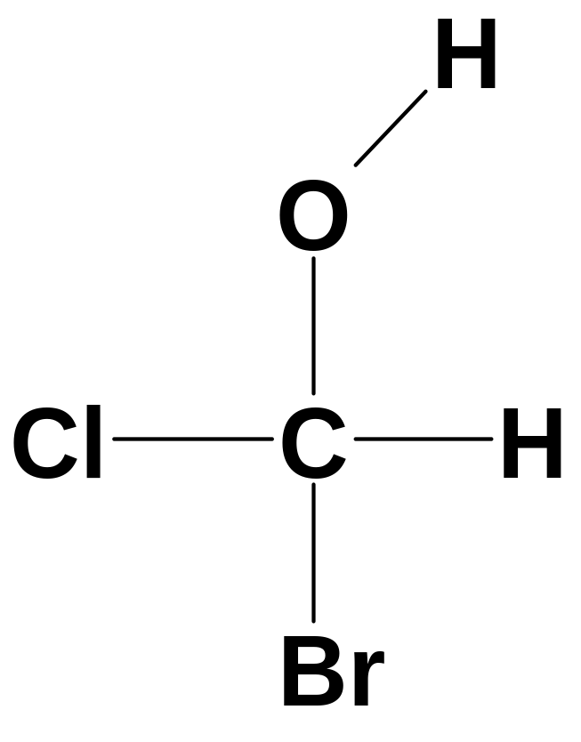
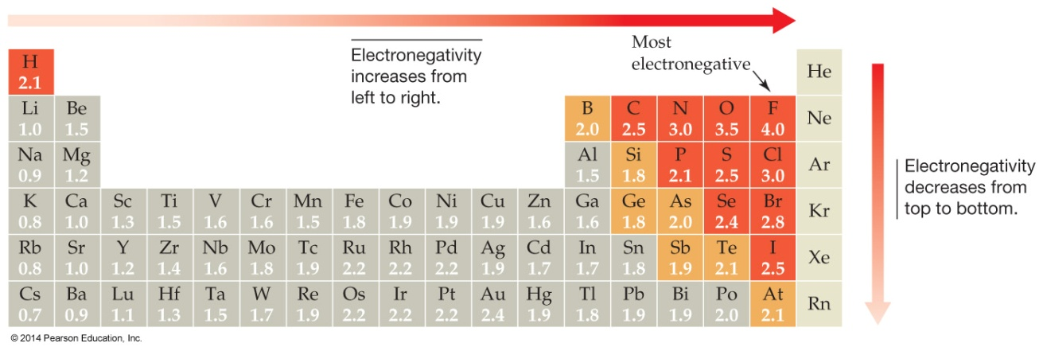
Which of the bonds in chlorofluoromethanol is
most polar?
a
b
d
c
e
© 2014 Pearson Education, Inc.
Notes:
Answer: a

Slide 29
Which of the bonds in chlorofluoromethanol is
most polar?
a
b
d
c
e
© 2014 Pearson Education, Inc.
Notes:
Answer: a

Slide 30
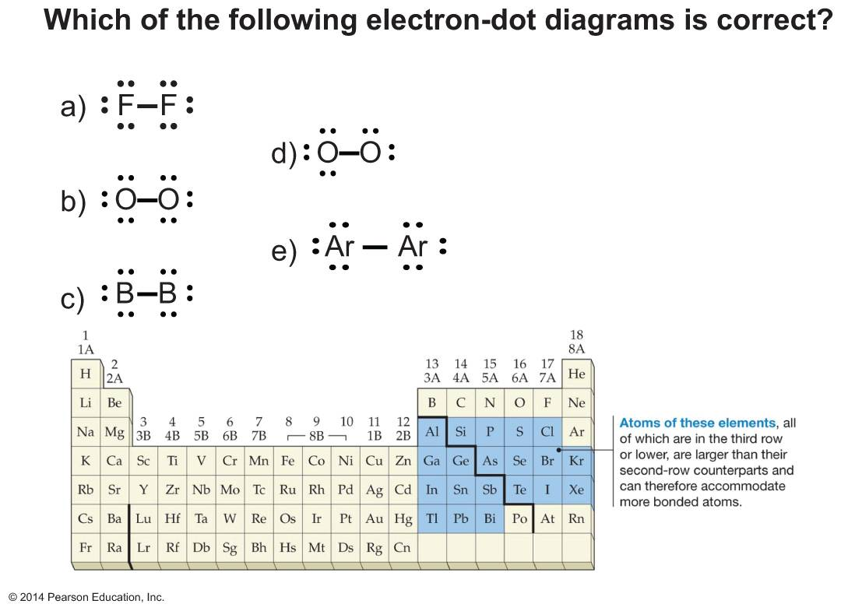
© 2014 Pearson Education, Inc.
Notes:
Answer: a

Slide 31

© 2014 Pearson Education, Inc.
Notes:
Answer: a

